Slide 1
CS763 Secure Software Development
Course Introduction
Yuting Zhang
BU METCS

Slide 2
Welcome to CS763
LFA:
In person + Remote:
Zoom expectations: name, profile picture, camera on
Activity participation: Q&A, discussion, student presentations
Course website: onlinecampus.bu.edu
Syllabus,
Lecture slides
Assignments (labs, written hws, project)
Quizzes (2 quizzes)
Discussion board
References

Slide 3

Maximize Your Learning Outcomes
What do we learn?
Fundamental Knowledge/concepts and technologies (tradeoff between breadth and depth)
Practical skills (technical skills (labs, research questions), & soft skills)
Thinking models (system thinking, critical thinking, think like an attacker, think outside the box). An interesting case: https://boingboing.net/2012/06/11/students-assigned-to-cheat-on.html)
Two Roles (software engineer & security engineer) + Two hats (white hat & black hat)
Your success is my success!
Offense

Slide 4
CS763 Secure Software Development
Introduction to Software Security
Yuting Zhang
BU METCS

Slide 5
Introduction/Motivation

Slide 6
CyberSecurity Statistics
https://www.comparitech.com/vpn/cybersecurity-cyber-crime-statistics-facts-trends/
There were 144.91 million new malware samples in 2019 (AV-Test) and we’re already at 113.10 million new samples in 2020 (as of midway through November 2020)
Malicious hackers are now attacking computers and networks at a rate of one attack every 39 seconds (University of Maryland)
81% of surveyed organizations were aﬀected by a successful cyberattack (CyberEdge Group 2020 Cyberthreat Defense Report)
93% of companies deal with rogue cloud apps usage (Imperva 2019 Cyberthreat Defense Report)
In Q3 of 2020, APWG detected almost 572,000 unique phishing websites and observed more than 367,000 unique phishing email subjects. (APWG’s Phishing Activity Trends Report for Q3 2020)
65.7% of COVID-19 related threats were spam email while 26.8% were malware. (ENISA Threat Landscape Report 2020 – Spam)
Most cybercrime is now mobile. 70% of online fraud is accomplished through mobile platforms. (RSA 2019 Current State of Cybercrime Report)
In the first half of 2019, the number of cyberattacks on IoT devices increased by 300%. (F-Secure Attack Landscape H1 2019)

Slide 7
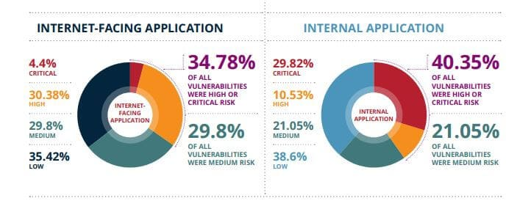
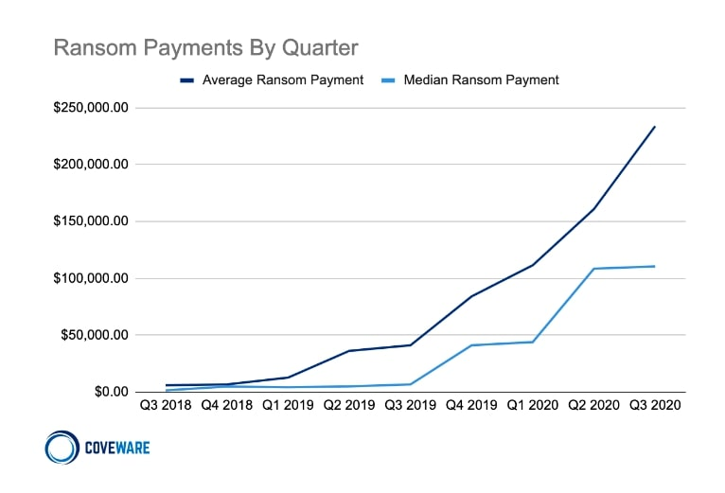
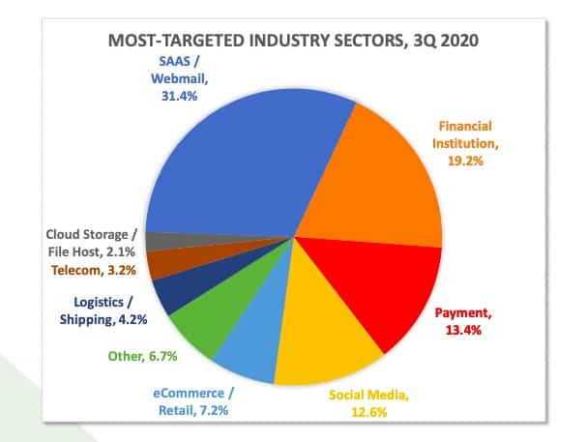

Slide 8
CyberSecurity Statistics
https://www.comparitech.com/vpn/cybersecurity-cyber-crime-statistics-facts-trends/
In 2019, 93.6% of malware observed was polymorphic, meaning it has the ability to constantly change its code to evade detection (2020 Webroot Threat Report)
Almost 90% of web applications are vulnerable to exploits. (Positive Technologies)
Google paid out 2.5 million in bug bounties in 2019 and has paid a total of $21 million since 2010. (Google)
Microsoft paid almost $14 million worth of bug bounties in 12 months. (Microsoft)
Facebook has a bounty program too and awarded around $2 million in just under 10 months in 2020. It’s largest payout to date was $80,000. (Facebook)
39% of companies mention that less than 2% of their total IT staff work in cybersecurity (EY Global Information Security Survey 2018-2019)
85% of organizations are challenged by IT security skills shortage, up from 84% in 2017 (Imperva 2020 Cyberthreat Defense Report)

Slide 9
Cyber Attacks
Type “cyber attacks” in google, you will find tons of news and reports.
Exercises: find a famous cyberattack in the last two or three years.
https://docs.google.com/spreadsheets/d/1MPT0smxmhK1GFz_9fiSfNH80qhN6aPExQh6k4MYfnBY/edit#gid=0
.

Slide 10
Why (Cyber) Security is So Important?
Cyber attacks are on the rise!!
Increasing in numbers, sophistication, severity and cost.
At all attack levels/scales: from the personal level to the organization level, to the national level.
Attackers: both insiders and outsiders, from script kiddies to professionals
Increased cyber attacks due to Covid-19 outbreaks and more remote workers.
Cloud breaches will increase and IoT become more vulnerable to cyberattacks
Like the public health, it is important to everyone!
Notes:
National warfare
Personal:Spam, identity theft, bots & zombies
James Clapper, director of national intelligence (DNI), stated that cyber security a critical element of national security (CENS). Richard Calarke defined cyber war as "actions by a nation-state to penetrate another nation's computers or networks for the purposes of causing damage or disruption". Former secretary of defense Leon Panetta once described cyber warfare as “the most serious threat in the twenty-first century,” capable of destroying our entire infrastructure and crippling the nation. Cyberterrorism Critical national infrastructure and high value targets are targeted Banking and financial Communication systems Electrical infrastructures Water resources Oil and gas Government Entities
larke first gives an overview of all the instances to date where cyber attacks have been used by state actors. In all cases but one (The Estonia attacks in 2007), the cyber attack was used to enhance a conventional attack. This is actually the best such overview I've seen, included some examples I hadn't heard of before, and Clarke's analysis is spot on. The only thing he didn't include was the very recent "operation aurora" (Google it if you want details), which probably occurred after he finished writing the book.
The book then has a detailed discussion of American policy on cyber warfare, and Clarke details all the developments to date. Since Clarke worked for presidents Clinton, Bush, and Obama on national security issues, this book provides a front row seat to the ins and outs of the way our policies have developed. Clarke also details what is known about the cyber war capabilities of other countries, including China, Russia, and North Korea

Slide 11
CyberSecurity/Information Security
Cybersecurity: the collection of tools, policies, security concepts, security safeguards, guidelines, risk management approaches, actions, training, best practices, assurance and technologies that can be used to protect the cyber environment and organization and user’s assets. (ITU definition)
Information Security: the protection of information against unauthorized disclosure, transfer, modification, or destruction, whether accidental or intentional. ”(ATIS definition)

Slide 12
Cybersecurity Fields
Computer Security
Network Security
Software Security (Application Security)
Cloud Security
IoT Security
Mobile Security
AI Security
...

Slide 13
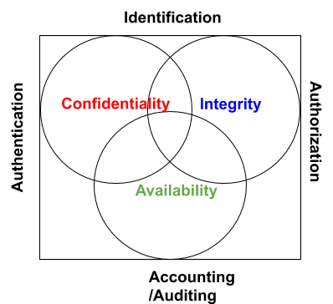
Information Security Goals: CIA
Confidentiality: prevents unauthorized use or disclosure of the stored and transferred information.
Integrity: prevents unauthorized modification of the stored and transferred information (guards the completeness and accuracy)
Accessibility: allows authorized users to have timely and reliable access of the information or service.
Examples?
Privacy?

Slide 14
Privacy
The right of a party to maintain control over and confidentiality of information about itself. (https://csrc.nist.gov/glossary/term/privacy)
Related to confidentiality (but not exactly the same)
Mostly associated with handling personal information (e.g. consent)
Privacy Regulations:
GDPR (General Data Protection Regulation)
HIPPA (Health Insurance Portability and Accountability)
GLBA (Gramm-Leach-Biley Act)
CCPA (California Consumer Privacy Act)

Slide 15
IAAA
Identification: Who is the one?
Authentication: Is the user authentic?
Login with username and password
Digital signature
Authorization: what authorized users can do (who can do what?)
Access list, capability list
Work together with authentication
Accountability (Audit): (record or identify who did what when and how)
Through Log
For access control, billing, planning, resource utilization, etc.
Nonrepudiation: assurance that someone cannot deny something

Slide 16
Some Security Controls
Crypto
Firewalls
Secure protocols
Penetration testing
Perimeter defense is dead?
Cloud computing, mobile computing, IoT changed traditional cyber systems
https://www.secureworldexpo.com/industry-news/cybersecurity-perimeter-defense-chris-roberts

Slide 17
Fundamental Problems
Cyber systems are too complex, exposing too many attack surfaces.
No magic screen to block all attacks. Traditional network security and perimeter solutions are not effective.
Software are everywhere. More software (code), more bugs, more attacks.
The growing connectivity and extensibility makes security problems even worse and harder.

Slide 18
Fundamental Problems
People are human, make all sorts of mistakes
Complete security is impossible.
Protection against both abuse and misuse.
Security is about risk and liability: lowering the risk to a reasonable level.
Cost of breach, and cost of fixing it.

Slide 19
Software Security
Software security is still in its infancy
Most software developers don’t know enough about security and most security engineering don’t know much about software development.(GitLab Survey results)
You cannot just add security around the software, you have to Build Security into the Software.

Slide 20
Software Security
The idea of engineering software so that it continues to function correctly under malicious attack
– Not firewalling vulnerabilities
– Not reacting through “penetrate and patch”
Instead – understanding, preventing, and mitigating software-induced security risks
(from NC state university “Software Security” Course https://sites.google.com/a/ncsu.edu/csc515-software-security/)

Slide 21
Software Security
Software security is an idea implemented to protect software against malicious attack and other hacker risks so that the software continues to function correctly under such potential risks. (www.techopedia.com)
Perimeter defense is not enough:
Firewall (App Vetting)
Penetration testing
Security built into the software
understanding, preventing, and mitigating software-induced security risks

Slide 22
Software Security vs Application Security
There are many types of software: OS, VM, Compiler, Browser, Database, plug-in, framework, etc
No program is an island. Attackers may exploit bugs/flags in any software.
It is a system-wide issue, need both security mechanisms and design for security.

Slide 23
Software Security is Everyone’s job
Developers
Operation people
Administrators
Users
Executives

Slide 24
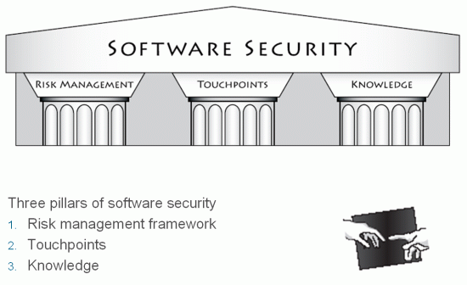
Software Security
Three areas:
Software engineering
Programming language
Security engineering
Gary McGraw, “Software Security, Building Security in”

Slide 25
Secure Software Development Process

Slide 26
IEEE Std 1074: Standard for Software Life Cycle Activities
IEEE Std 1074
Life Cycle Modeling
Project
Management
Pre-
Development
Develop-
ment
Post-
Development
Cross-
Development
> Project Initiation
>Project Monitoring
&Control
> Software Quality
Management
> Concept
Exploration
> System
Allocation
> Requirements
> Design
> Implemen-
tation
> Installation
> Operation &
Support
> Maintenance
> Retirement
> V & V
> Configuration
Management
> Documen-
tation
> Training
Software Project Management Plan (SPMP)

Slide 27
Activities
Inception: scope, major functionality, target customers, related systems (high-level idea)
Planning: estimation of cost, work items, schedule, resource, high-level activities. Feasibility study, configuration management plan (need update throughout the project)
Requirements Analysis: gather and analyze functional and nonfunctional requirements

Slide 28
Activities
Software Design: architecture and detailed design (OOD)
Implementation: program code
Testing: unit-testing, module and integration testing and system testing.
Maintenance: defect repair and quality enhancement
Umbrella activities: generic activities implemented throughout the life of a project (e.g. project management, configuration management, quality management, risk management)

Slide 29
Software Development Process
A software development process is a structure imposed on the development of a software product:
prescribes the order and frequency of phases
specifies criteria for moving from one phase to the next
defines the deliverables of the project
Software process has positive effect if applied correctly
Meet schedules, Higher quality, More maintainable
Software process models include
Sequential model: waterfall
Iterative and incremental models: spiral, unified, agile

Slide 30
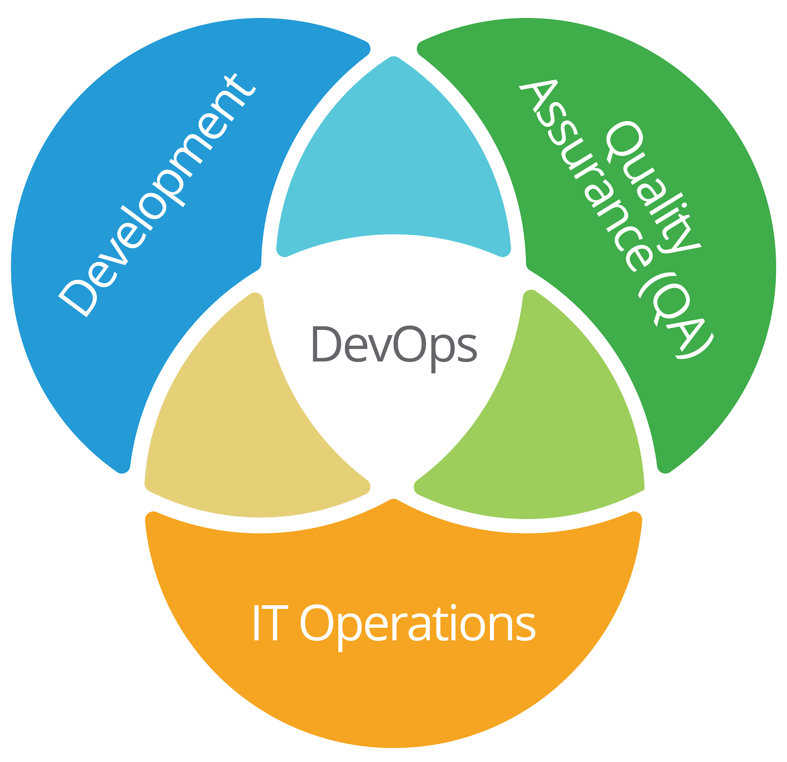
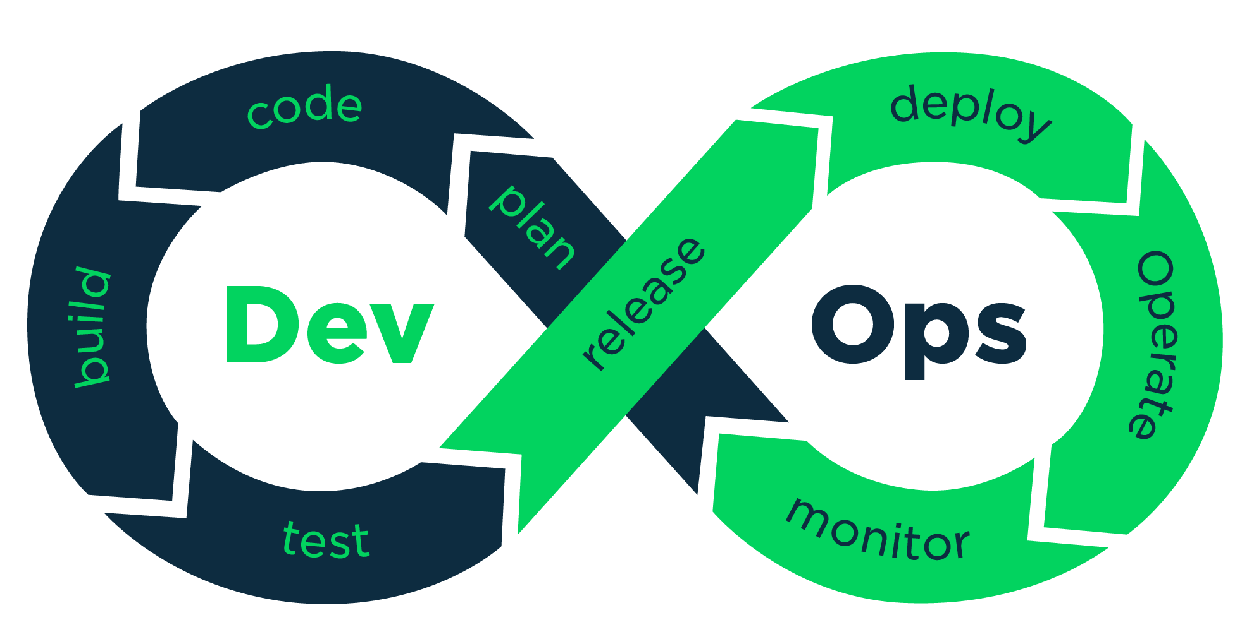
DevOps

Slide 31
Secure Software Development Process Model
Security should be considered in all activities in the devop lifecycle.
Examples:
Touchpoints ( BSIMM from Cigital )
Microsoft SDLC
OWASP SAMM

Slide 32
Bugs, Flaws and Vulnerabilities
A bug is an implementation level software problem (buffer overflow, format string, resource leaks, simple race condition)
A flaw is instantiated in software code, but stem from at the design level (deeper level). (e.g. inconsistent error handling)
McGraw argues that the software security problems are divided 50/50 between bugs and flaws. ([McGraw, 2001] Table 1-2 P17)
Vulnerability: A weakness ( a design flaw or a implementation bug ) that may be exploited by a threat source (a malicious attacker)
Risk: Vulnerabilities lead to risk. The goal is to minimize the risk by minimizing the vulnerabilities and blocking threats.

Slide 33
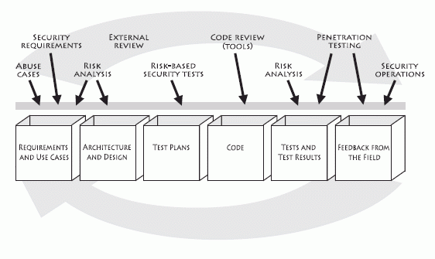
Seven Touchpoints
An iterative approach
In the order of effectiveness
Code review
Architectural risk analysis
Penetration testing
Risk-based security tests
Abuse cases
Security Requirements
Security operations
External Analysis
Artifacts
Figure 1-9 on [McGraw, 2010]P28
Process-agnostic

Slide 34
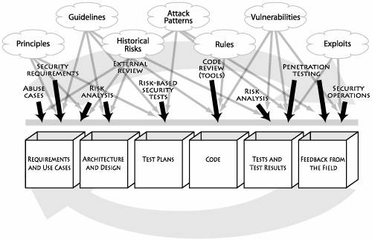
Seven Touchpoints
7 Knowledge catalogs into 3 Knowledge categories
Prescriptive
Diagnostic
Historical
Figure 1-12 on [McGraw, 2010] Page 37

Slide 35
Seven Touchpoints
7 Knowledge catalogs into 3 Knowledge categories
Prescriptive
Diagnostic
Historical
What are missing here?
Figure 1-12 on [McGraw, 2010] Page 37

Slide 36
Microsoft SDL
Three core concepts: education, continuous process improvement, and accountability.
A collection of mandatory activities, presented in the order they should occur and grouped by the phases of the traditional software development life cycle (SDLC).
Security and privacy roles: reviewer/advisory roles(auditor, expert) and team champions.
Focus on quality and treat security as part of quality.
Provide tools for those security practices
https://www.microsoft.com/en-us/securityengineering/sdl/
SDL timeline: https://www.microsoft.com/en-us/securityengineering/sdl/about

Slide 37
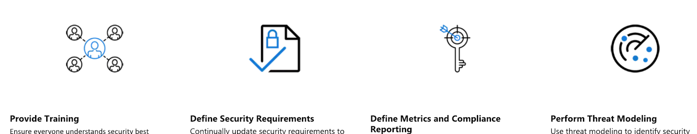
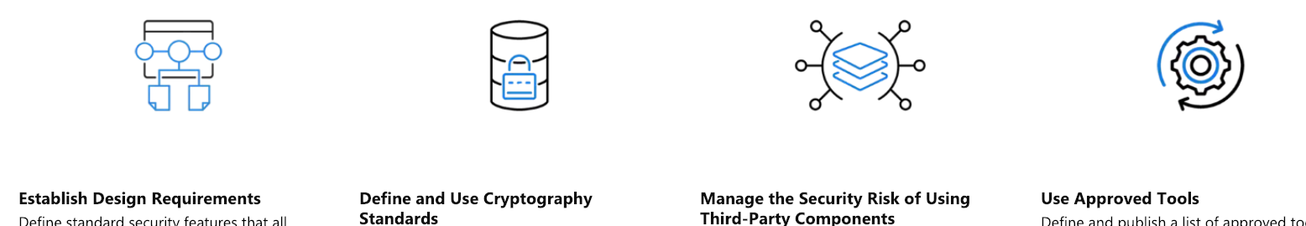
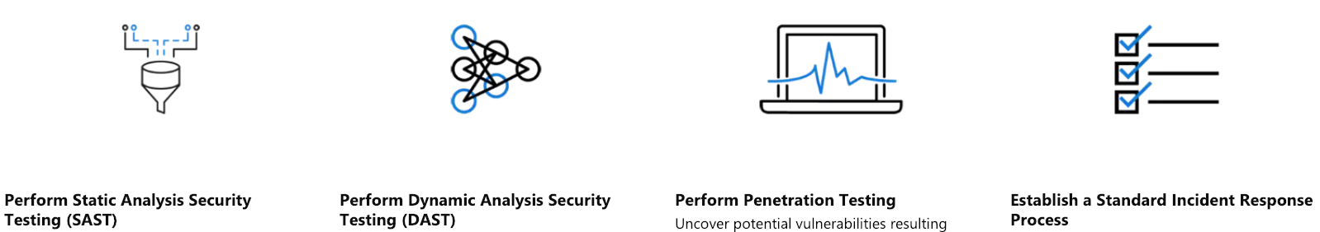
SDL Practices

Slide 38
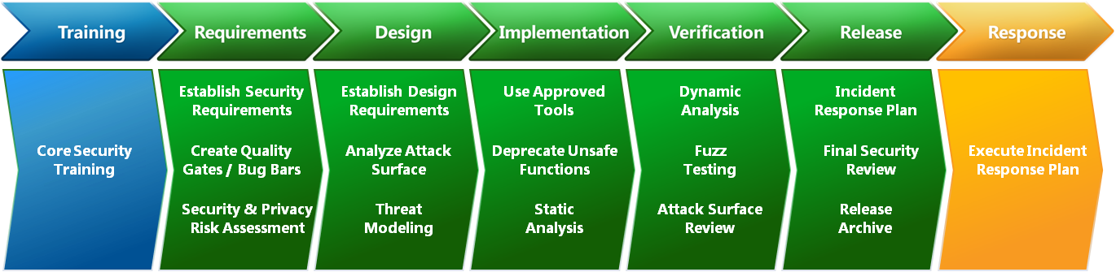
Microsoft SDL

Slide 39
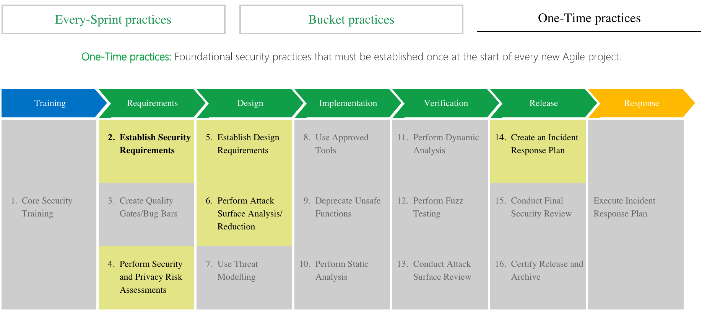
SDL for Agile

Slide 40
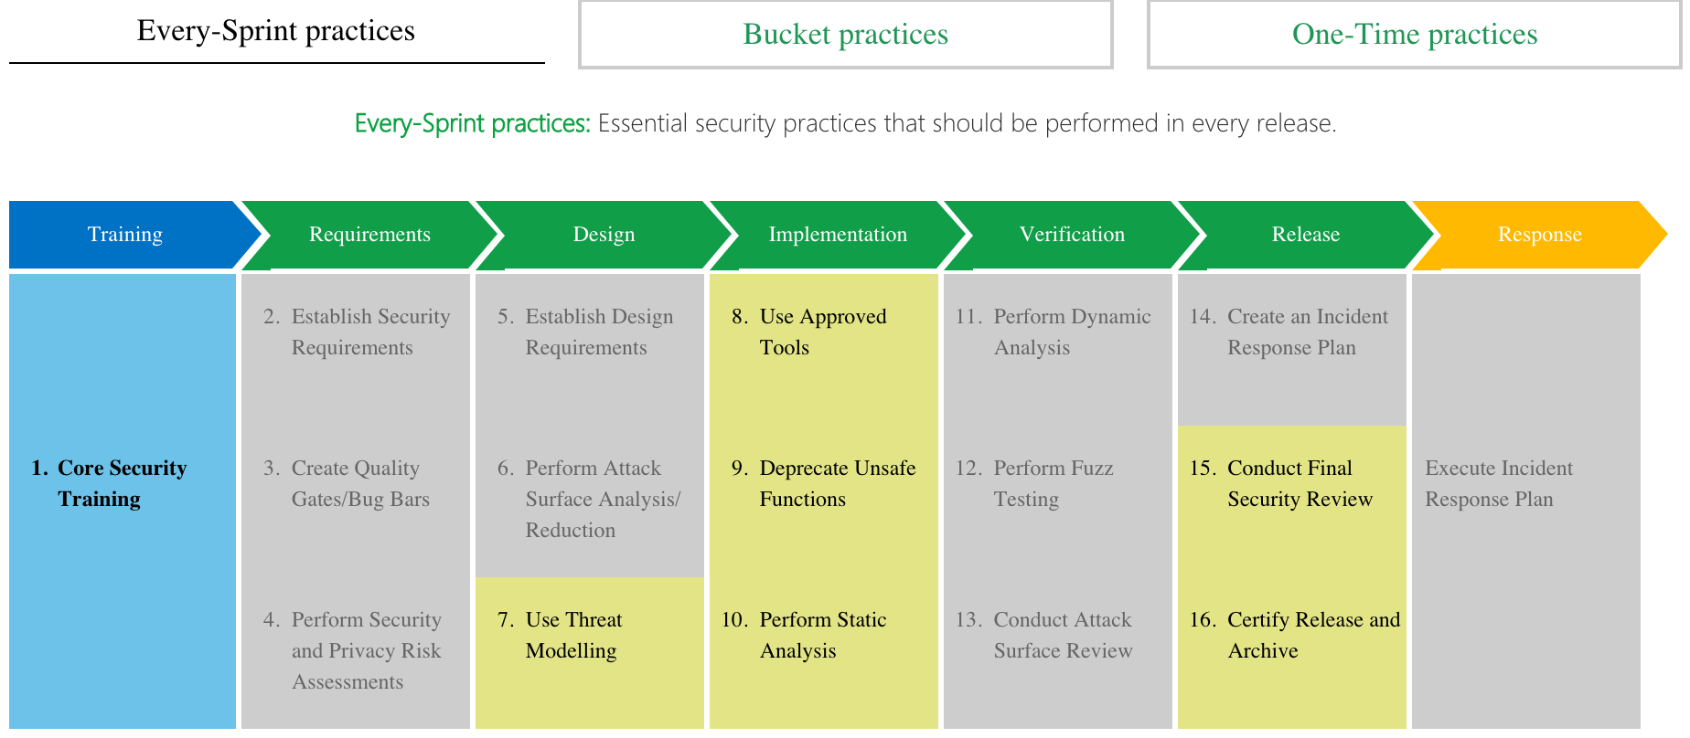
SDL for Agile

Slide 41
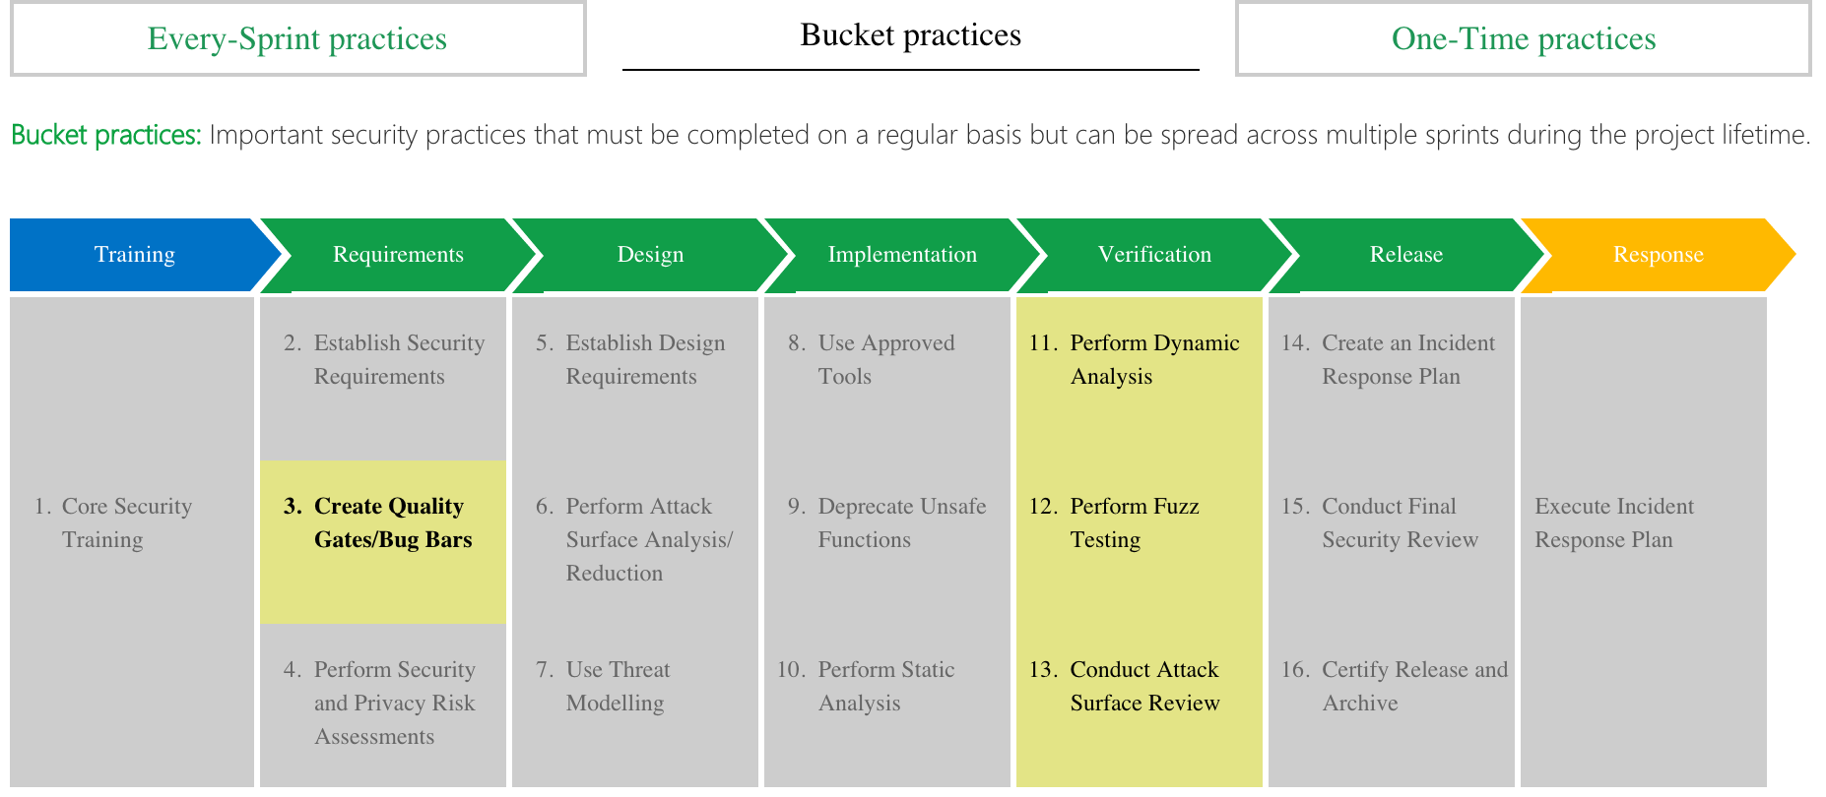
SDL for Agile

Slide 42
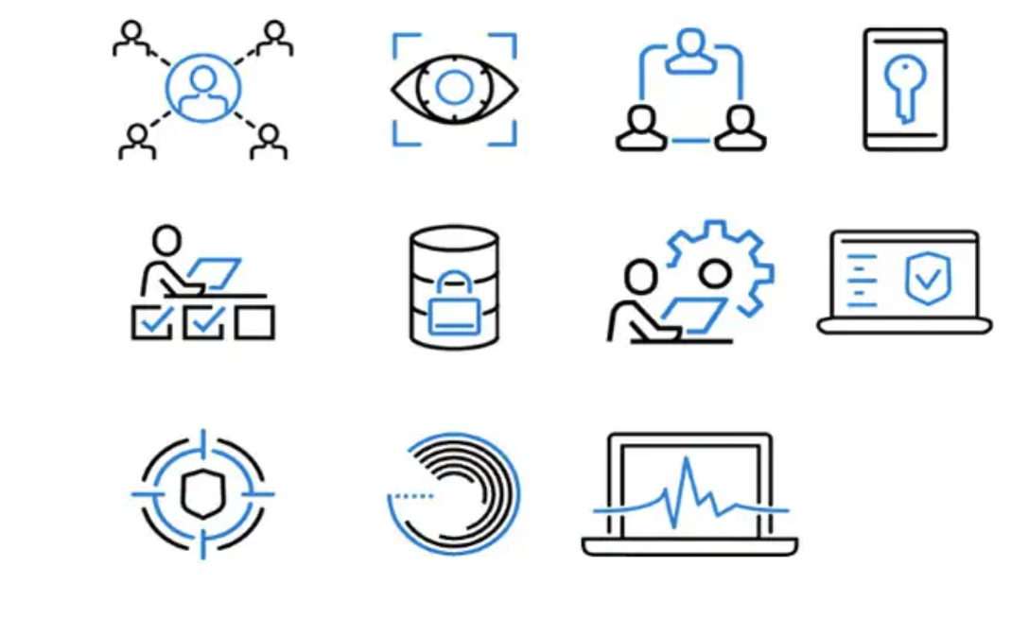
Operational Security Assurance (OSA)
https://www.microsoft.com/en-us/securityengineering/osa/practices

Slide 43
OWASP SAMM
The Software Assurance Maturity Model (SAMM) is an open framework to help organizations formulate and implement a strategy for software security that is tailored to the specific risks facing the organizations. (https://www.owasp.org/index.php/OWASP_SAMM_Project )
SAMM v1.0 was written by Pravir Chandra in 2009. SAMM v2.0 was released with an updated SAMM Toolbox and a new Benchmark initiative.
It can be used by projects or organizations in different sizes.
Flexible, iterative, risk-based, detailed, well-defined, measurable
SAMM is version controlled to help manage its evolution. Github link: https://github.com/OWASP/samm. All the model content has been converted to YAML files, allowing tools or other SAMM consumers to automatically use the model.

Slide 44
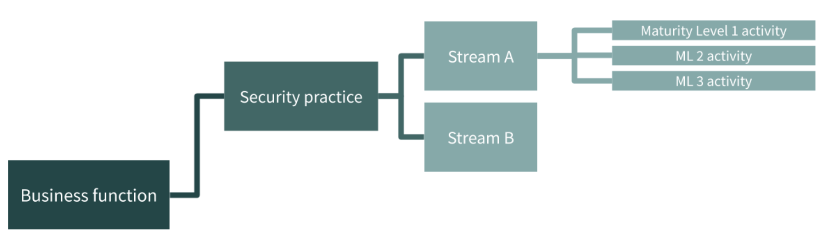
OWASP SAMM
1: Ad hoc provision
2: Increased efficiency and effectiveness
3: Comprehensive mastery at scale
3 practices in each business functions
For each security practice, SAMM defines three maturity levels.
Activities in each practice are grouped in logical flows and divided into two streams. Each stream covers different aspects of the practice and has its own objectives, aligning and linking the activities in the practice over the different maturity levels.
5 Business functions

Slide 45
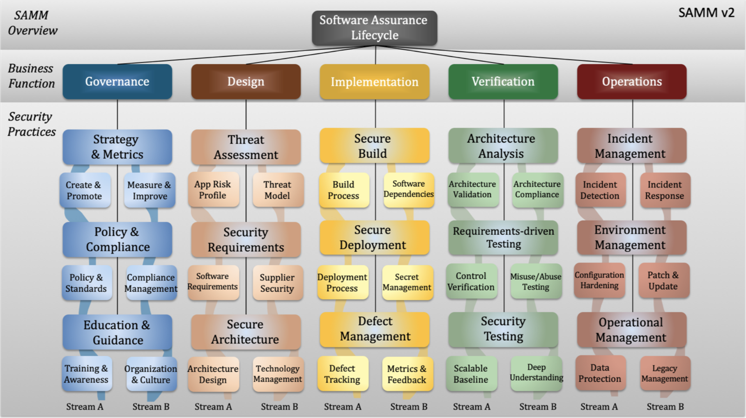
OWASP SAMM
5 Business functions and 15 security practices (https://owaspsamm.org/)
The Pdf version:

Slide 46
OWASP SAMM
Exercises: each group picks two security practices and conducts some research. Then report back.

Slide 47
Secure Software Development Process
Comparison: similarities & differences?
Security Practices - ?
Education and Awareness - ?
Maturity Level and Metrics - ?
Specific tools - ?
Which one do you want to adopt?
Problems, Limitations: https://techbeacon.com/why-existing-secure-sdlc-methodologies-are-failing

Slide 48
Questions?

